Slide 1
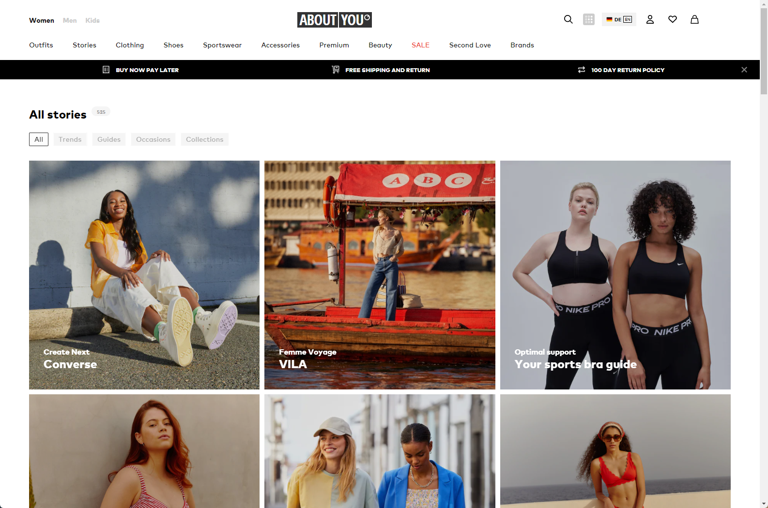

ABOUT YOU

Slide 2

Overview of ABOUT YOU
The European company ABOUT YOU GmbH is famous in e-commerce.
It is a leading fashion and lifestyle e-commerce portal in Europe.
Due to its personalized and customer-centric approach, it become most popular e-commerce platform.
The company uses cutting-edge technology and data-driven analysis.
ABOUT YOU's wide selection, unique features, and dedication to customer satisfaction have earned it a strong market position and a varied consumer base.

Slide 3

Importance of ethics in modern business
Ethical business practices build and maintain client, associate, and community trust.
Ethical companies stand out and attract ethical customers by developing a good brand.
Morality fosters productivity, attracts great talent, and promotes morale.
Ethical business methods cut legal risks, strengthen stakeholder relationships, and solidify the organization.
Corporate ethics today reflect the growing expectation that corporations will benefit society. This serves huge social groups and clients.

Slide 4
Ethics: Systematic Study of What is Right or Wrong
Morality is methodized by ethics.
Decision making tool helps people and organizations make moral decisions.
Ethics considers social, cultural, and ethical aspects within situations and civilizations.
Professional codes of conduct explain ethical principles and help professionals resolve industry-specific moral issues.
Emphasizing consequences encourages self-awareness and ethical thought.

Slide 5
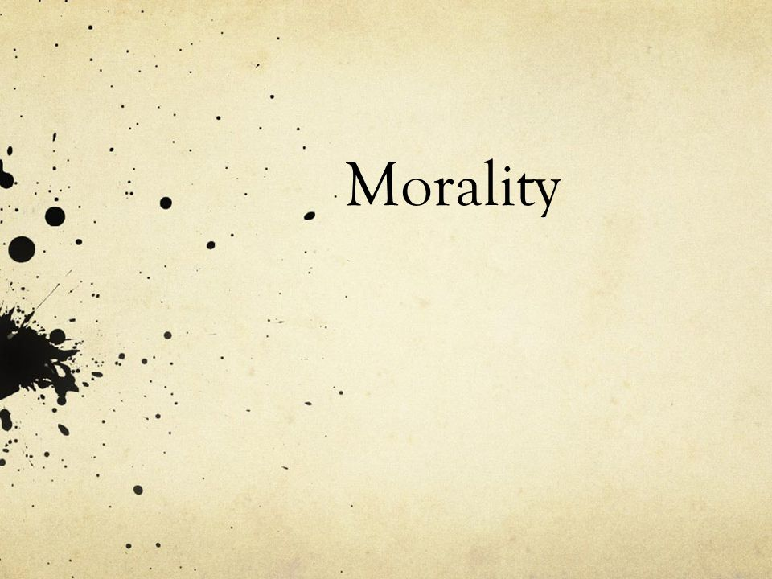
Morality is subjective because it depends on one's ethics and right and wrong.
Culture, family, and personal experiences shape personal morality, making it unique and complex.
Morality is subjective and involves feelings, kindness, compassion, and right and wrong.
As people mature, learn, and make decisions, their moral compass may change. This makes people adaptable.
Human activity requires morality. Moral decisions are guided by this internal ethics.

Slide 6
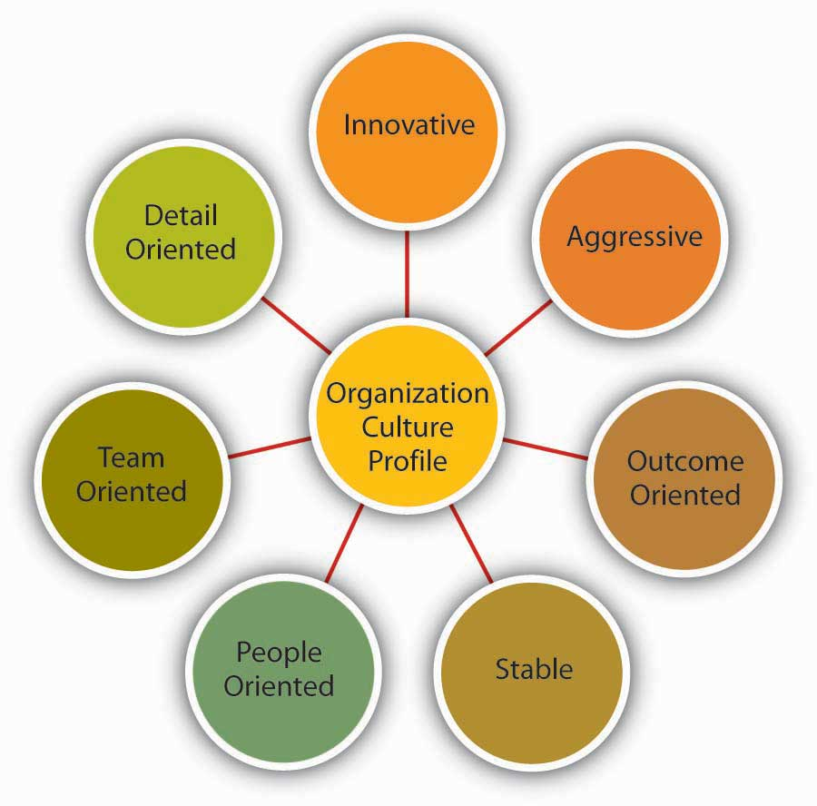
Dimensions of "Unternehmensethik" (Corporate Ethics) at ABOUT YOU
For moral issues like supplier and environmental difficulties, ABOUT YOU provides ethical frameworks.
The company's ethical dispute resolution is impartial, open, and commercially ethical.
Through sustainable business and philanthropy, ABOUT YOU encourages social responsibility.
CSR helps the company improve society and operate responsibly.
ABOUT YOU practices Vernunfthik by making appropriate decisions about its long-term impacts on society and the environment.

Slide 7
Dimensions of "Unternehmensethik" (Corporate Ethics) at ABOUT YOU
The company mixes ethics and practicalities in long-term environmental decisions.
Concerning YOU encourages partners, employees, and clients to contribute ethical solutions.
Discussing common ideas promotes understanding, cooperation, and accountability.
ABOUT YOU's company culture ensures morality in all business activities.
Organization funds staff Conflict, Responsibility, Reason, and Dialogue Ethics awareness and training.

Slide 8

Relevance of Ethics in Business:
Building and maintaining customer trust requires ethics.
Companies that prioritize ethics gain customer trust and loyalty.
Business ethics boost brand image.
A reputable company can attract honest and ethical customers.
Ethics are increasingly crucial in hiring and retaining great talent.

Slide 9
Relevance of Ethics in Business:
Top talent seeks ethical employers, and ethical organizations attract more prospects.
Ethics decreases legal and regulatory concerns.
Ethics-driven companies follow the law, reducing legal issues.
Ethical business methods build profitable, long-term relationships with suppliers, investors, consumers, and the community.
These alliances support corporate longevity.

Slide 10

Economic Rationality Alone is Insufficient:
Economic theory can limit strategy to short-term profitability over long-term company decisions.
Economics' disregard to society and the environment may lead to profit-driven decisions above ethical ones.
Big, sustainable businesses often prioritize profits over ethics and social issues.
Rigid economic ideas can lead to profit-driven harm to stakeholders and communities.
Morality can be sacrificed for profit, harming reputation and shareholder faith.

Slide 11
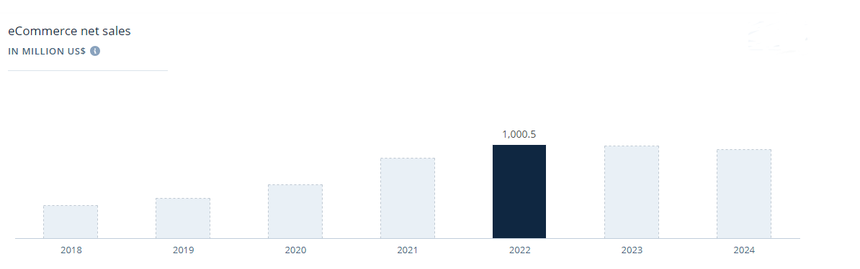

Slide 12
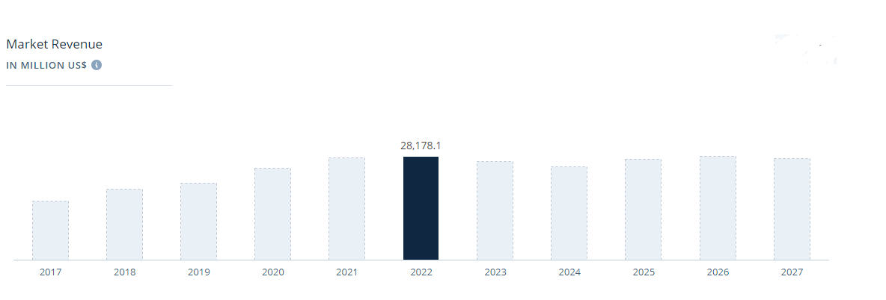

Slide 13
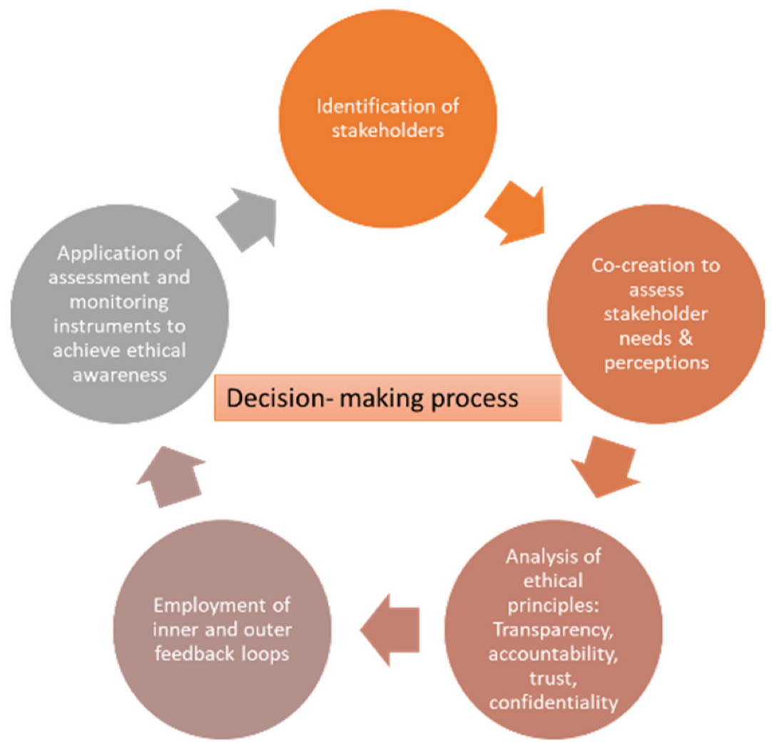
Ethical Considerations are Necessary for Comprehensive Decision-Making:
Business sustainability requires environmental, social, and governance ethics beyond profit.
Clients, employees, and the community gain from ethical decisions. This promotes business ties and long-term goals.
Companies' reputations depend on ethics. Companies that prioritize ethics gain reputation, competitive advantage, and brand value.
Ethics involves following the law, minimizing legal duties, and maintaining moral organizational procedures that meet standards.
CSR means a commitment to successful business practices that benefit people and the environment.

Slide 14
Rahmensetzung (Framework Setting)
Concerning ABOUT YOU sets clear employee ethics.
Business decisions are based on company ethics. Conduct norms define morals and behavior.
Rahmensetzung guarantees operational openness, responsibility, and morality for ABOUT YOU stakeholders.
It follows tight ethics rules. Audits, public reporting, and training are used.
Rahmensetzung establishes an organization-wide moral code that matches ABOUT YOU.

Slide 15

Reflektiertes Handeln in Freiheit (Reflective Action in Freedom)
About You Employees can make ethical judgments based on their principles and rigorous evaluation due to personal accountability.
Reflective Action in Freedom says workers should discuss moral issues from diverse angles.
Reflective Action in Freedom fosters ethical decision-making and innovation in the workplace.
Adaptability will enable the organization seize new possibilities and address ethics.
Employees use reflective action skills to make ethical judgments that match company and personal ideals.

Slide 16

Instrumental Use of Morals at ABOUT YOU:
ABOUT YOU distributes ethical items and encourages social responsibility to its target market.
Promoting ethical products builds loyalty. Buyers with ethics may trust you.
Fair labour, sustainable materials, and environmental restrictions may raise ethical fashion production costs
Ethical clothing may initially suffer from higher production costs and lower margins.
Regarding Rising production costs may challenge competition. Corporations may suffer against ethically lenient competitors.

Slide 17

Balancing Profitability and Responsibility
You act ethically and sustainably. Green customers may assist businesses.
Business ethics like honesty and sustainability promote consumer trust. Choose ethical companies to retain customers.
Suppliers and communities balance profit and duty. Good stakeholder connections improve corporate performance.
Innovation in environmental ethics matters. Firm goes green and ethical.
Helping stakeholders understand accountability and financial gain. Moral and cost-conscious transparency lowers the issue.

Slide 18

Enabling Ethical Actions at ABOUT YOU
Integrating ethics throughout all business processes.
Promoting innovation, teamwork, and social responsibility.
Selecting Employees Who Follow ABOUT YOU's Ethics.
Professional growth and ethics training.
Morality in business strategy yields best results.

Slide 19

Leadership and Communication
Create a culture where ethics guide behavior.
Transparent and real communication helps transmit and preserve ethics.
Leaders model behavior based on clear ethical principles.
Discuss ethics with employees to foster empathy and loyalty.
To ensure success, assess and enhance communication strategies.

Slide 20

Involvement in Strategic Planning
Contribute to strategic judgments for detailed business planning.
Morality should lead decision-making to impact the strategic company plan.
Morality and organizational values must guide strategic decisions.
Be thorough and ethical when preparing.
Ethics are essential for long-term success.

Slide 21
Gesinnungsethik at ABOUT YOU
Consider internal morality when making decisions.
Shared values-driven decisions to promote ethics.
Align your behaviors with your values to practice virtue ethics.
Internal moral norms provide a trustworthy and ethical context for decision-making.
Ethics can be developed together with shared values.

Slide 22
Long-Term Thinking: Vernunftethik
Using rational decision-making to maintain organizational effectiveness.
Developing ethics by assessing decisions against personal convictions over time.
Balance long-term ethics and financial rewards.
Promoting ethical decision-making for lasting impact.
Vernunftethik prioritizes long-term social and environmental impacts while making decisions.

Slide 23
Dialogical Approach: Dialogethik
Maintaining stakeholder, employee, and client communication.
Establish strong dialogic links using shared concepts to increase understanding.
Recognizing and respecting different opinions within agreed ideals improves debate.
Through communal conversation, virtue ethics helps generate moral answers.
Dialogethik improves moral conversation and collaboration by promoting ethical communication.

Slide 24

Conclusion
At ABOUT YOU, we prioritize stakeholder engagement, leadership, communication, and ethics.
An ethical and sustainable business must balance profit with responsibility.
Leadership ensures values and actions coincide, producing accountability.
Ethics increases customer loyalty, trust, and business reputation.
Morality reduces economic disruptions through relationships.

Slide 25
Conclusion
Ethical behavior strengthens client and partner relationships.
Virtue eases legal and regulatory issues.
Ethics encourage open communication, making them essential in emergencies.
Social norms improve self-esteem and community well-being.
Ethics helps companies develop long-term wealth and stability.

Slide 26

References
Kopetz, H. and Steiner, W., 2022. Real-Time Communication. In Real-time systems: Design principles for distributed embedded applications (pp. 177-200). Cham: Springer International Publishing.
Matusov, E., 2015. Comprehension: A dialogic authorial approach. Culture & Psychology, 21(3), pp.392-416.
Riegel, B. and Jaarsma, T., 2019. Self-care in long term conditions: Old news or new thinking?. International journal of nursing studies, 90, pp.A1-A1.
Spinoza, B., 2017. Ethics. Lulu. com.
Heinze, R.G., Klie, T. and Kruse, A., 2015. Subsidiarität revisited. Sozialer Fortschritt, 64(6), pp.131-138.
Krebs, D., 2015. The evolution of morality. The handbook of evolutionary psychology, pp.747-771.
Jain, V.I.P.I.N., Malviya, B.I.N.D.O.O. and Arya, S.A.T.Y.E.N.D.R.A., 2021. An overview of electronic commerce (e-Commerce). Journal of Contemporary Issues in Business and Government, 27(3), pp.665-670.

Slide 27



